Slide 1
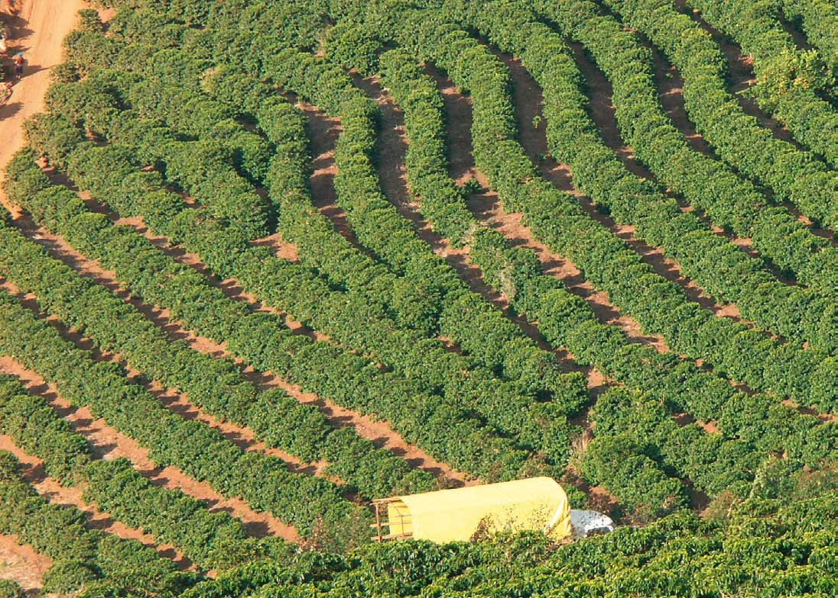
DATA STRUCTURES FOR EARLY DETECTION OF BLIGHT PLAGUE ON COFFEE PLANTATIONS
Simón Flórez Silva
Adrián Alberto Gutiérrez Leal
Medellín, 2019 October 29th 2019

Slide 2
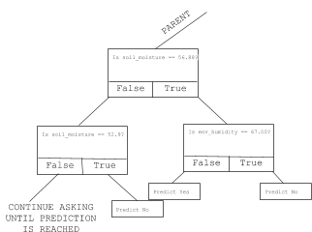
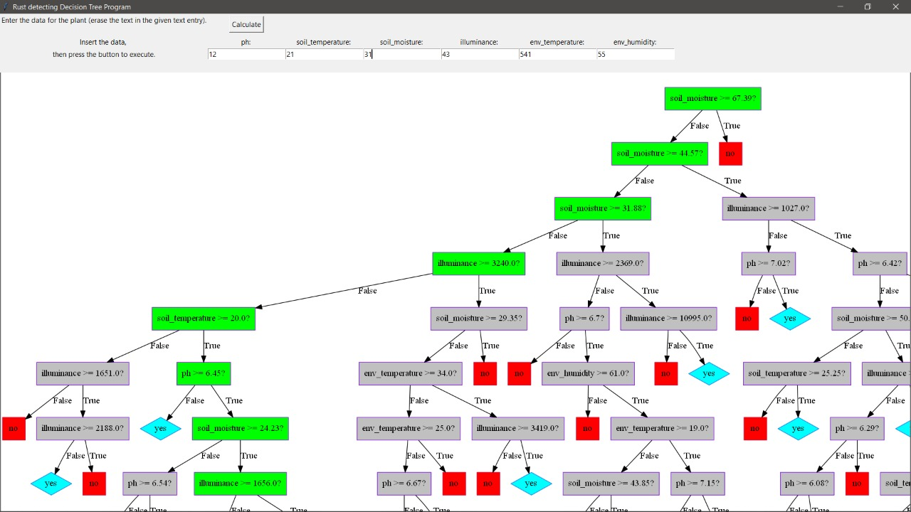
Designed Data Structure
Figure 1.1: Tree of Coffee Data. Each node represents a type of data which will generate a hierarchy based on the type and value to determine sickness.
Figure 1.2: Actual footage of the application.

Slide 3
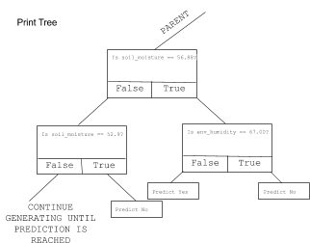
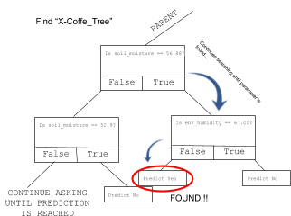
Data Structure Operations
Figure 2.1: Print
Shows each node of the Tree as it generates them.
Figure 2.2: Classify
Searches each node for a specific input data
Method | Complexity
Print Tree | O(2^{n})
Classify | O(log₂n)
Train (with C4.5) | O(m⋅n²)
Table 5: Table to report complexity analysis.

Slide 4
Design Criteria of the Data Structure
Implementation of a decision tree considers every outcome based on the data it has.
Allows to take the best possible decision for a problem for which solution would be otherwise uncertain.
Trees are easy to implement, due to them being based on simple math.
Trees provide visual representation of data.
The C4.5 implementation can handle incomplete data.
C4.5 helped to reach an acceptable accuracy.

Slide 5
Time and Memory Consumption
Memory Used
Execution Time
 | Data set test 1 | Data set test 2 | Data set test 3
Train | 5.9 s | 8.53 s | 6.9 s
Print Tree | 0.0014 s | 0.0068 s | 0.0036 s
Classify | 0.076 ms | 0.037 ms | 0.93 ms
 | Data set 1 | Data set 2 | Data set 3
Memory Consumption | 44.8 MB | 48.5 MB | 48.2 MB
Table 7: Memory used for each attempt.
Table 6: Execution time of the operations of the data structure for each data set.

Slide 6
Implementation
Figure 4: User interface that shows decision.

